Slide 1
Maths
Unit 8 – Addition and subtraction.
06.10.2026
WALT: Compose, decompose and regroup numbers, including decimals.

Slide 2
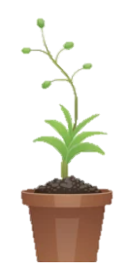
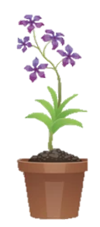
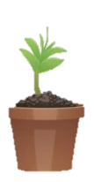
WALT: Compose, decompose and regroup numbers, including decimals.
I can fill in missing numbers to complete composition and decomposition.
I can compose, decompose and regroup numbers.
I can correct mistakes in composition and decomposition.

Slide 3
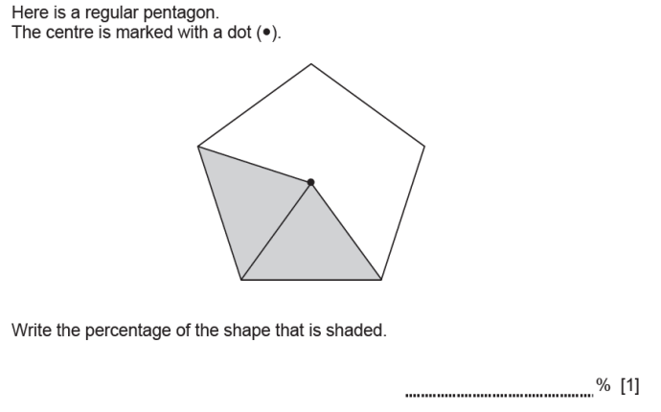
Retrieval Practice
WALT: Compose, decompose and regroup numbers, including decimals.
40

Slide 4
Starter – What mistake has been made?
WALT: Compose, decompose and regroup numbers, including decimals.
1
5
.
8
+
5
.
2
1
6
.
2
9

Slide 5
WALT: Compose, decompose and regroup numbers, including decimals.
Starter
What do these represent?
ones
hundredths
tenths
thousandths
2.391

Slide 6
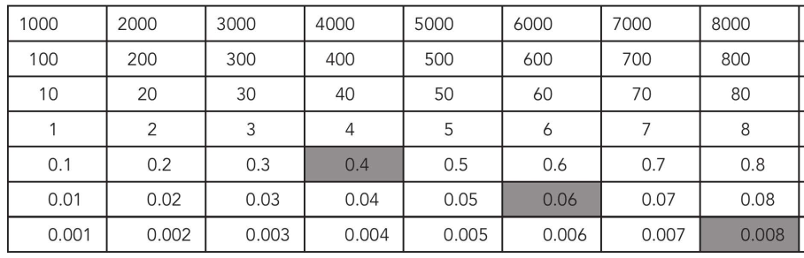
WALT: Compose, decompose and regroup numbers, including decimals.
On your whiteboards write down the number that the shaded squares represent.
0.468

Slide 7
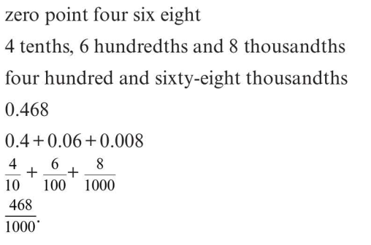
WALT: Compose, decompose and regroup numbers, including decimals.
0.468
What different ways of saying or writing this number can you think of?

Slide 8
WALT: Compose, decompose and regroup numbers, including decimals.
TTYP
What do these mean?
Compose
Decompose
Regroup

Slide 9
How would you decompose this number?
Is there more than one way?
WALT: Compose, decompose and regroup numbers, including decimals.
0.4 + 0.06 + 0.008
We can regroup this number. We can do this to help with addition and subtraction.
0.3 + 0.16 + 0.008

Slide 10
Check your understanding.
WALT: Compose, decompose and regroup numbers, including decimals.
0.3
Fill in the missing value: 456.32 = 400 + 50 + 6 + ___ + 0.02
Decompose this number in two different ways.
653.723
3. Mr. Charlie says, “34.543 decomposed is 30 + 4 + 0.5 + 0.4 + 0.3”.
What mistake has he made?
600 + 50 + 3 + 0.7 + 0.02 + 0.003
610 + 40 + 3 + 0.7 + 0.02 + 0.003 etc…
He has not got the place value of the hundredths and thousandths correct.

Slide 11
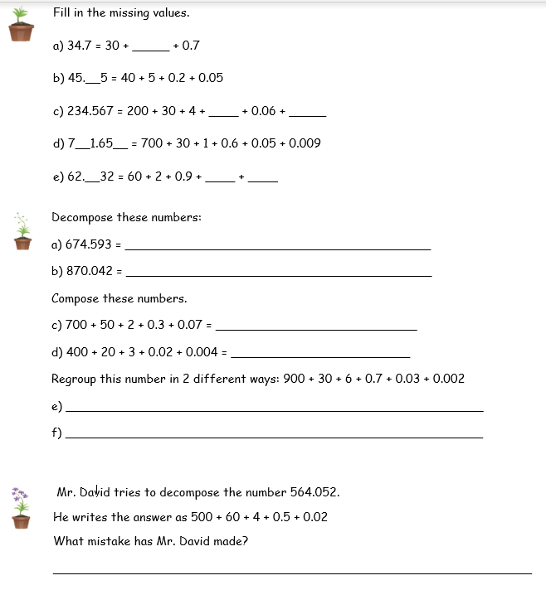
WALT: Compose, decompose and regroup numbers, including decimals.

Slide 12
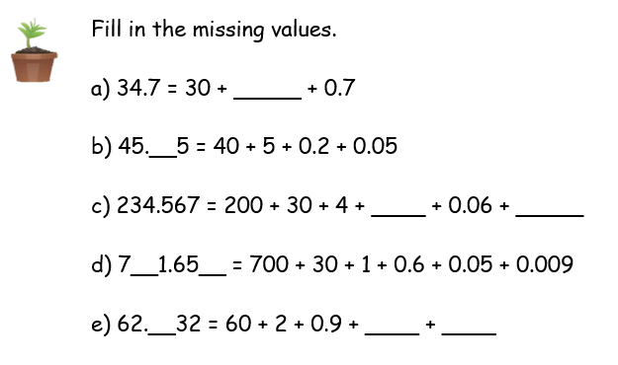
WALT: Compose, decompose and regroup numbers, including decimals.
4
2
0.5
0.007
3
9
9
0.03
0.002

Slide 13
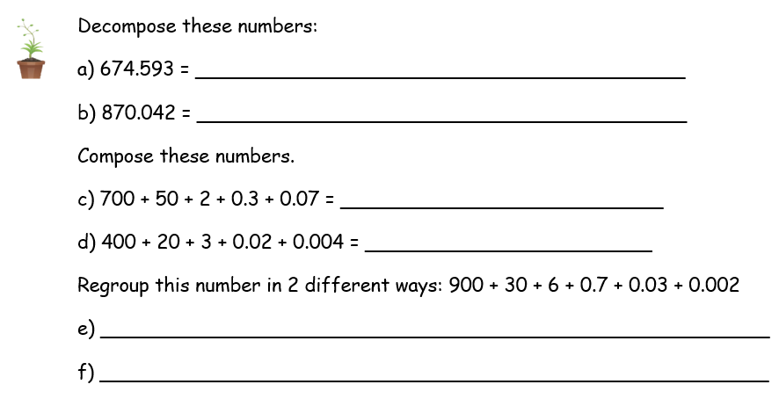
WALT: Compose, decompose and regroup numbers, including decimals.
600 + 70 + 4 + 0.5 + 0.09 + 0.003
800 + 70 + 0.04 + 0.002
752.37
423.024
910 + 20 + 6 + 0.7 + 0.03 + 0.002
900 + 30 + 6 + 0.7 + 0.02 + 0.012 etc…

Slide 14
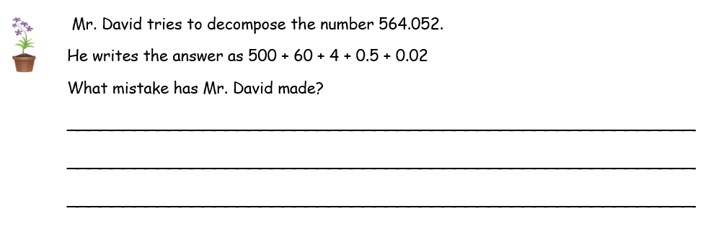
WALT: Compose, decompose and regroup numbers, including decimals.
His place value for the decimal values are not correct. The “5” is 0.05 not 0.5 and the “2” is 0.002 not 0.02.

Slide 15
WALT: Compose, decompose and regroup numbers, including decimals.
I can fill in missing numbers to complete composition and decomposition.
I can compose, decompose and regroup numbers.
I can correct mistakes in composition and decomposition.

